Slide 1
IU International Hochschule – Fernstudium Modul : Programmierung mit C/C++ (DLBROEPRS01_D) Tutor : Prof. Dr. Hajck Karapetjan Semester : 3. semester Vollzeit Hex,Bin,Text Editor C++_Project Conception Phase
Mohamed safa Ben rhouma
Bachelor of Elektrotechnik
Matrikelnummer : 32205321

Slide 2
Introduction
In this Presentation we will introduce the Hex,Bin,Text Editor C++ App designed to convert a file content between Hexadecimal , binary and text
We will list the method and concept used to build it as well as how we will make it easy for the user to try it
And how to use the app and run it

Slide 3
Qt framework
Qt frame work provides libraries and tools that makes it easier to develop an app with a graphical user interface GUI like widgets
File I/O : we used QFile and QTextStream classe to read with files and write on them
QRegularExpression : this class allow us to detect the file type

Slide 4
Qt Test frame work
Is a Qt frame work to run UnitTests
We used the QTest class to assure the functionality of our code and tools like QCompare

Slide 5
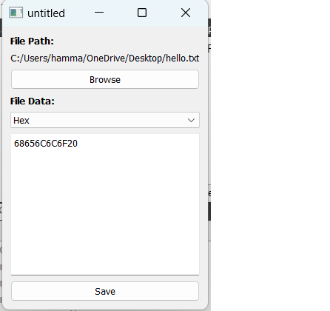
Running the App
Navigating the app is easy and understandable to the user thanks to the simplified GUI
We need first to made a .txt file containing our content
When launched , the app will show a browse button , which allow us to chose the
File that we are going to operate on
After opening the file we will see under file data the option that allow us to choose
The type that we want to convert into

Slide 6
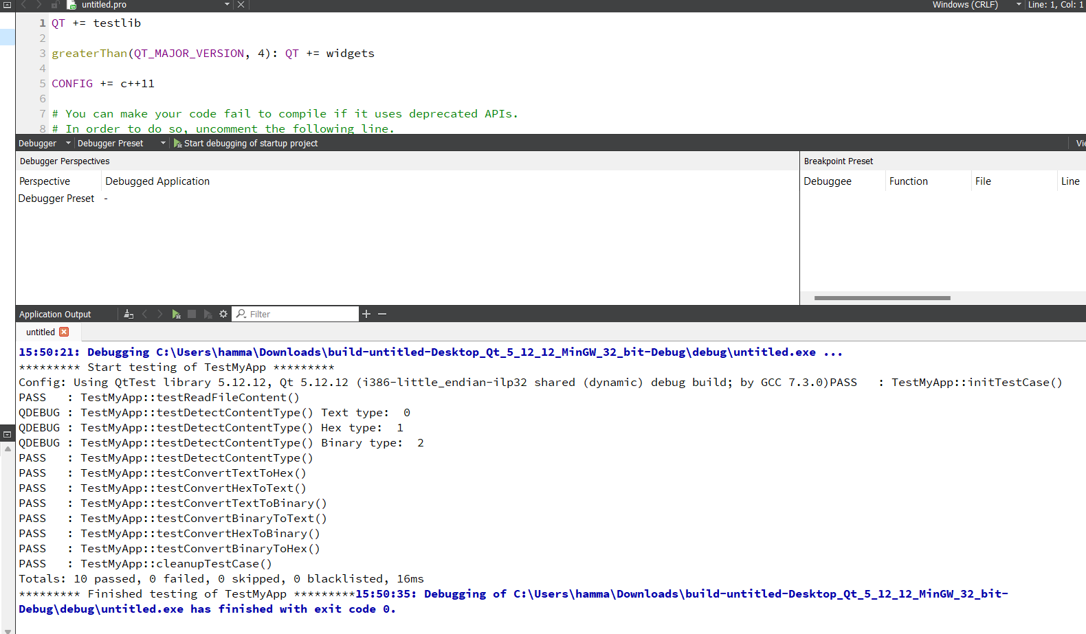
Unit Tests

